Slide 1
Lecture 9
Other Examples of Simulation

Slide 2
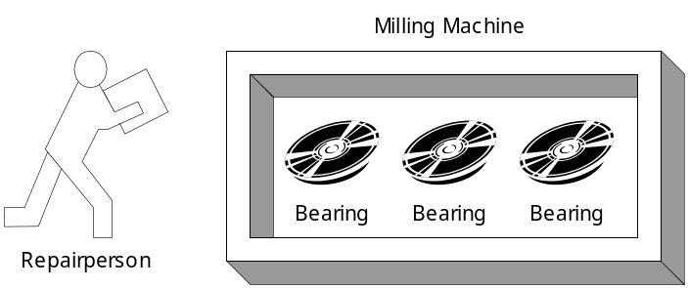
Other Examples of Simulation (1)
Example 2.5 A Reliability Problem
  Downtime for the mill is estimated at $5 per minute.
  The direct on-site cost of the repairperson is $15 per hour.
  It takes 20 minutes to change one bearing, 30 minutes to change two bearings, and 40 minutes to change three bearings.
  The bearings cost $16 each.
  A proposal has been made to replace all three bearings whenever a bearing fails.

Slide 3
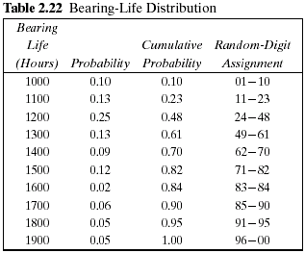
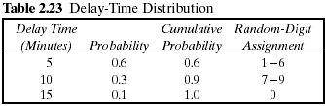
Other Examples of Simulation (2)
Example 2.5 (Cont.)
  The delay time of the repairperson's arriving at the milling machine is also a random variable, with the distribution given in Table 2.23.
  The cumulative distribution function of the life of each bearing is identical, as shown in Table 2.22.

Slide 4
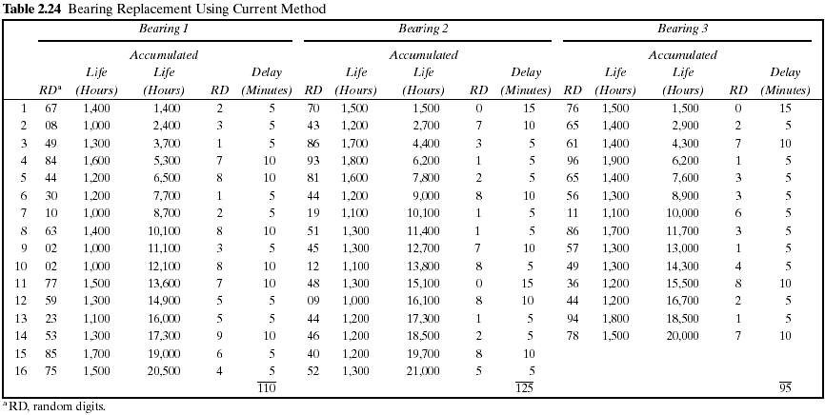

Slide 5
Other Examples of Simulation (3)
Example 2.5 (Cont.)
  Table 2.24 represents a simulation of 20,000 hours of operation under the current method of operation.
  Note that there are instances where more than one bearing fails at the same time.
  This is unlikely to occur in practice and is due to using a rather coarse grid of 100 hours.
  It will be assumed in this example that the times are never exactly the same, and thus no more than one bearing is changed at any breakdown. Sixteen bearing changes were made for bearings 1 and 2, but only 14 bearing changes were required for bearing 3.

Slide 6
Other Examples of Simulation (4)
Example 2.5 (Cont.)
  The cost of the current system is estimated as follows:
    Cost of bearings = 46 bearings × $16/bearing = $736
    Cost of delay time = (110 + 125 + 95) minutes × $5/minute = $1650
    Cost of downtime during repair =
    46 bearings × 20 minutes/bearing × $5/minute = $4600
    Cost of repairpersons =
    46 bearings × 20 minutes/bearing × $15/60 minutes = $230
    Total cost = $736 + $1650 + $4600 + $230 = $7216
  Table 2.25 is a simulation using the proposed method. Notice that bearing life is taken from Table 2.24, so that for as many bearings as were used in the current method, the bearing life is identical for both methods.

Slide 7
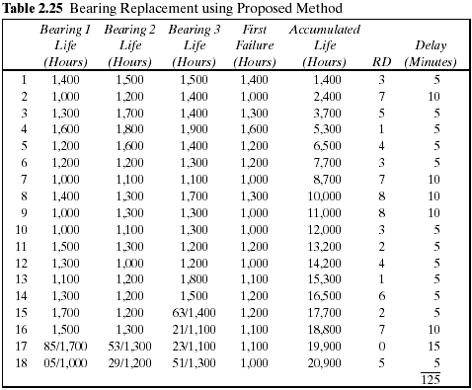

Slide 8
Other Examples of Simulation (5)
Example 2.5 (Cont.)
  Since the proposed method uses more bearings than the current method, the second simulation uses new random digits for generating the additional lifetimes.
  The random digits that lead to the lives of the additional bearings are shown above the slashed line beginning with the 15th replacement of bearing 3.
  The total cost of the new policy :
    Cost of bearings = 54 bearings × $16/bearing = $864
    Cost of delay time = 125 minutes × $5/minute = $625
    Cost of downtime during repairs = 18 sets × 40 minutes/set × $5/minute = $3600
    Cost of repairpersons = 18 sets × 40 minutes/set × $15/60 minutes = $180
    Total cost = $864 + $625 + $3600 + $180 = $5269
  The new policy generates a savings of $1947 over a 20,000-hour simulation. If the machine runs continuously, the simulated time is about 2 1/4 years. Thus, the savings are about $865 per year.

Slide 9
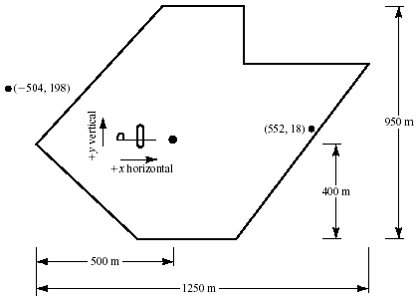
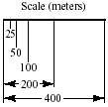
Other Examples of Simulation (6)
Example 2.6 Random Normal Numbers
  A classic simulation problem is that of a squadron of bombers attempting to destroy an ammunition depot shaped as shown in Figure 2.8.

Slide 10
Other Examples of Simulation (7)
Example 2.6 (Cont.)
  If a bomb lands anywhere on the depot, a hit is scored. Otherwise, the bomb is a miss.
  The aircraft fly in the horizontal direction.
  Ten bombers are in each squadron.
  The aiming point is the dot located in the heart of the ammunition dump.
  The point of impact is assumed to be normally distributed around the aiming point with a standard deviation of 600 meters in the horizontal direction and 300 meters in the vertical direction.
  The problem is to simulate the operation and make statements about the number of bombs on target.

Slide 11
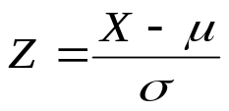









Other Examples of Simulation (8)
Example 2.6 (Cont.)
  The standardized normal variate, Z, with mean 0 and standard deviation 1, is distributed as
  where X is a normal random variable, is the true mean of the distribution of X, and is the standard deviation of X.
  In this example the aiming point can be considered as (0, 0); that is, the value in the horizontal direction is 0, and similarly for the value in the vertical direction.
  where (X,Y) are the simulated coordinates of the bomb after it has fallen
  and

Slide 12
Other Examples of Simulation (9)
Example 2.6 (Cont.)
  The values of Z are random normal numbers.
    These can be generated from uniformly distributed random numbers, as discussed in Chapter 7.
    Alternatively, tables of random normal numbers have been generated. A small sample of random normal numbers is given in Table A.2.
    For Excel, use the Random Number Generation tool in the Analysis TookPak Add-In to generate any number of normal random values in a range of cells.
  The table of random normal numbers is used in the same way as the table of random numbers.
  Table 2.26 shows the results of a simulated run.

Slide 13
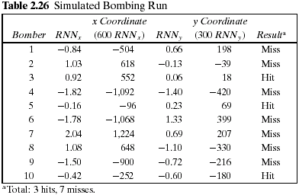
Other Examples of Simulation (10)
Example 2.6 (Cont.)

Slide 14


Other Examples of Simulation (11)
Example 2.6 (Cont.)
  The mnemonic stands for .random normal number to compute the x coordinate. and corresponds to above.
  The first random normal number used was –0.84, generating an x coordinate 600(-0.84) = -504.
  The random normal number to generate the y coordinate was 0.66, resulting in a y coordinate of 198.
  Taken together, (-504, 198) is a miss, for it is off the target.
  The resulting point and that of the third bomber are plotted on Figure 2.8.
  The 10 bombers had 3 hits and 7 misses.
  Many more runs are needed to assess the potential for destroying the dump.
  This is an example of a Monte Carlo, or static, simulation, since time is not an element of the solution.

Slide 15
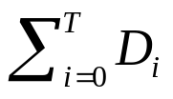
Other Examples of Simulation (12)
Example 2.7 Lead-Time Demand
  Lead-time demand may occur in an inventory system.
  The lead time is the time from placement of an order until the order is received.
  In a realistic situation, lead time is a random variable.
  During the lead time, demands also occur at random. Lead-time demand is thus a random variable defined as the sum of the demands over the lead time, or
  where i is the time period of the lead time, i = 0, 1, 2, … , D_{i} is the demand during the i^{th} time period; and T is the lead time.
  The distribution of lead-time demand is determined by simulating many cycles of lead time and building a histogram based on the results.

Slide 16
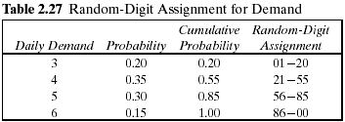

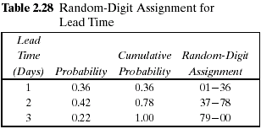

Other Examples of Simulation (13)
Example 2.7 (Cont.)
  The daily demand is given by the following probability distribution:
  The lead time is a random variable given by the following distribution:

Slide 17
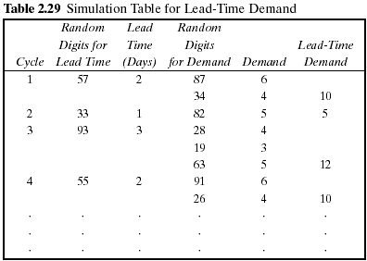
Other Examples of Simulation (14)
Example 2.7 (Cont.)
  The incomplete simulation table is shown in Table 2.29.
  The random digits for the first cycle were 57. This generates a lead time of 2 days.
  Thus, two pairs of random digits must be generated for the daily demand.

Slide 18
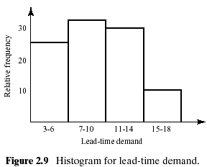
Other Examples of Simulation (15)
Example 2.7 (Cont.)
  The histogram might appear as shown in Figure 2.9.
  This example illustrates how simulation can be used to study an unknown distribution by generating a random sample from the distribution.

